Slide 1
Quality Control for Single Cell RNA-seq Data Daniel Chafamo Seq 28, 2022

Slide 2
Topics
Overview of steps to go from raw sequencing files to count matrices
Quality control for single cell RNA-Seq Data
Normalization of single cell RNA-Seq data

Slide 3
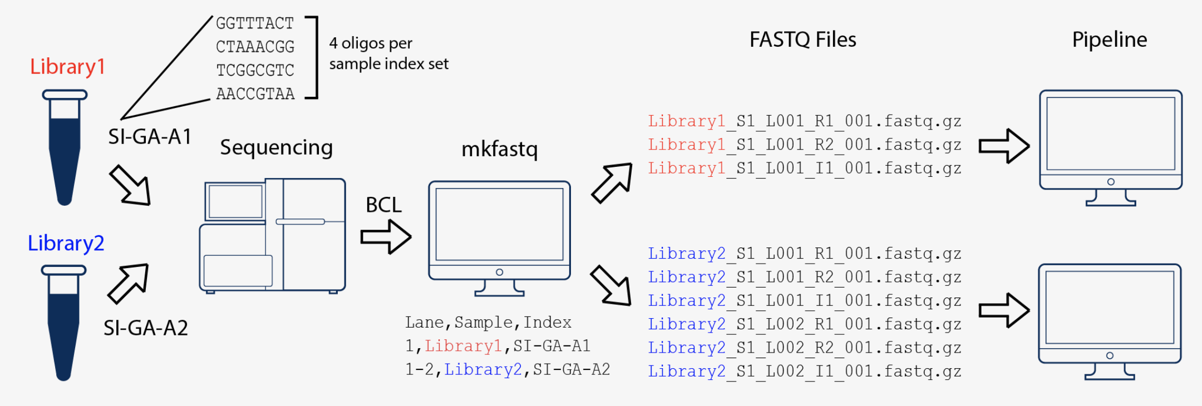
Raw sequencing files to count matrices Step 1: BCL to FASTQ
The primary output of Illumina sequencing instruments are per-cycle base call files in BCL format.
The first step is to convert these BCL files to fastq files used by most downstream software. This includes separating reads into individual fastq files based on their barcode (demultiplexing), adapter masking/trimming and moving unique molecular identifier (UMI) bases from the read to the fastq header.
Source: 10X Genomics

Slide 4
Raw sequencing files to count matrices Step 1: BCL to FASTQ
A FASTQ file is a text file that contains the sequence data which consists of:
A sequence identifier with information about the sequencing run and the cluster.
The sequence (the base calls; A, C, T, G and N).
A separator, which is simply a plus (+) sign.
The base call quality scores.
Example sequence in a FASTQ
@HWI-ST808:130:H0B8YADXX:1:1101:2088:2222:CELL_GGTCCA:UMI_CCCT
AGGAAGATGGAGGAGAGAAGGCGGTGAAAGAGACCTGTAAAAAGCCACCGN
+
@@@DDBD>=AFCF+<CAFHDECII:DGGGHGIGGIIIEHGIIIGIIDHII#

Slide 5
Raw sequencing files to count matrices Step 2: Alignment to reference genome
The next step is to determine which gene each read originated from. In order to do this the read sequences are mapped to a precompiled genome reference.
Many tools have been developed for read alignment.
10X Cellranger uses the STAR aligner. For each read in the FASTQ, STAR tries to find the longest possible sequence which matches one or more sequences in the reference genome.
Because of widespread splicing in animal genomes, read alignment against a genome has to be done with a splice-aware aligner.

Slide 6
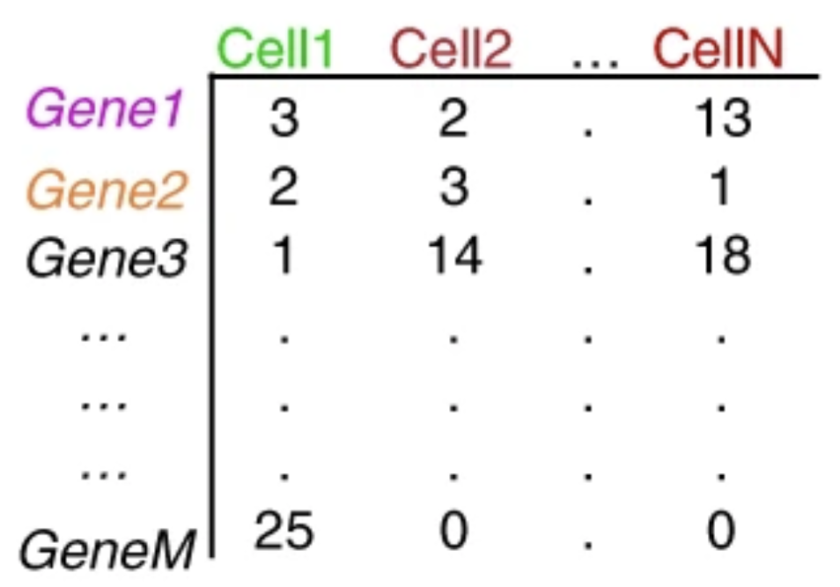
Raw sequencing files to count matrices Step 3: Counting reads
Reads that have been confidently mapped to the transcriptome are then assigned to cells based on their barcode (cell barcode demultiplexing) and the the number of unique RNA molecules corresponding to each gene within each cell are counted (UMI deduplication).
The result is the gene x cell matrix that is the starting point for downstream analysis:

Slide 7
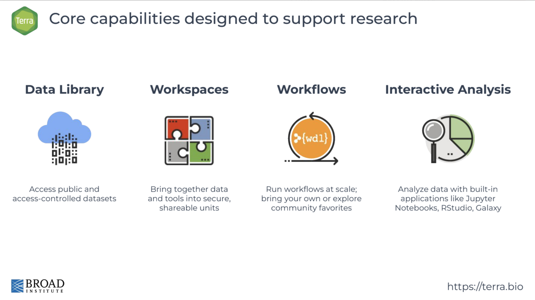
Terra: a scalable platform for biomedical research

Slide 8
Quality Control
Goals:
Filter the data to only include true cells that are of high quality
Remove empty droplets
Remove doublets
Remove dead or damaged cells
Remove ambient RNA
Identify any failed samples and either try to salvage the data or remove from analysis
Challenges:
Delineating cells that are poor quality from less complex cells
Choosing appropriate thresholds for filtering, to keep high quality cells without removing biologically relevant cell types
Notes:
Failure to remove low quality cells at this stage may add technical noise which has the potential to obscure the biological signals of interest in the downstream analysis.

Slide 9
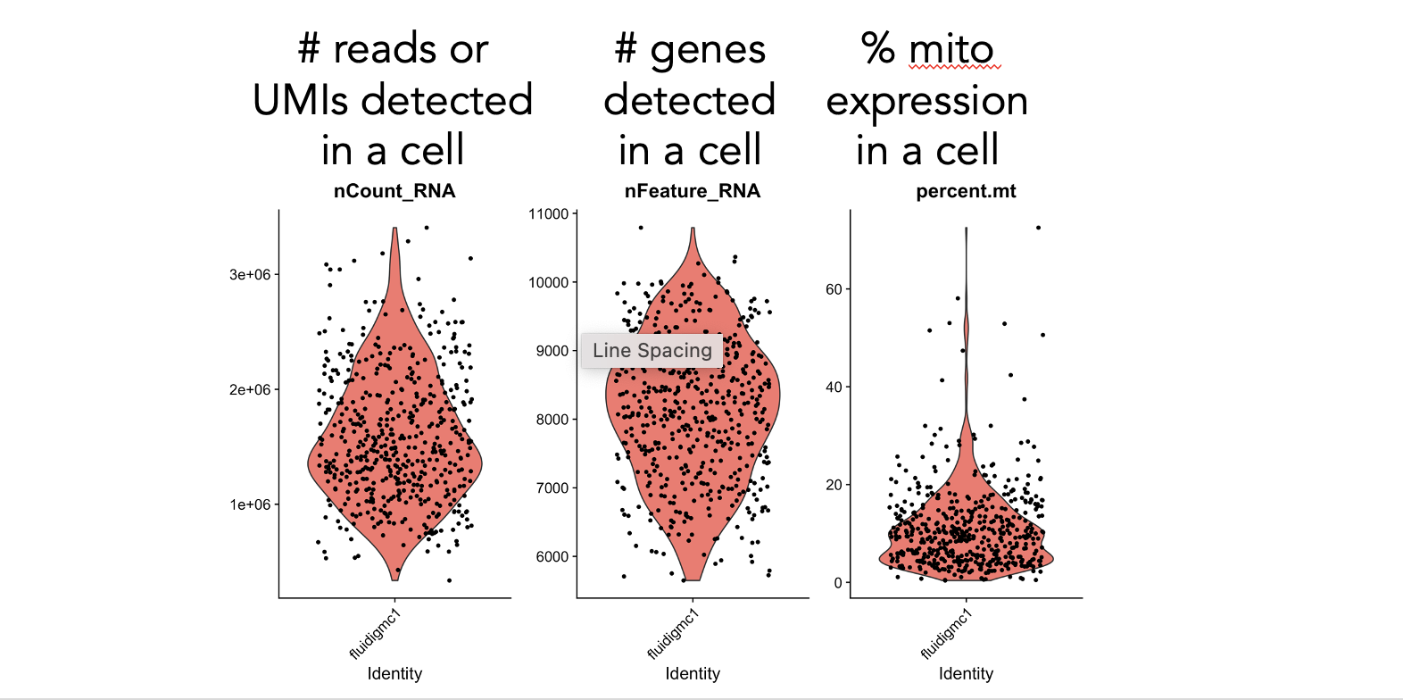
Fundamental QC metrics
Cell QC is commonly performed based on three principal QC covariates:
the number of counts per barcode (count depth),
the number of genes per barcode, and
the fraction of counts from mitochondrial genes per barcode
Notes:
Failure to remove low quality cells at this stage may add technical noise which has the potential to obscure the biological signals of interest in the downstream analysis.

Slide 10
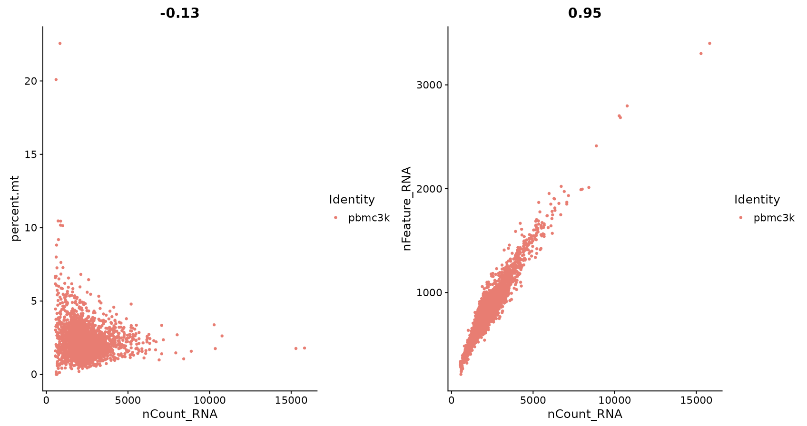
Fundamental QC metrics
It is sometimes helpful to use a combination of these metrics to filter out cells.
Low nUMI and high % mitochondrial - Cells captured but lost a lot of the mRNA, and the mitochondrial genes were protected and retained.
High nUMI & low nGene ratio – low quality library or capture rate
High nUMI & high nGene – doublets
.
.
.
Notes:
Failure to remove low quality cells at this stage may add technical noise which has the potential to obscure the biological signals of interest in the downstream analysis.

Slide 11
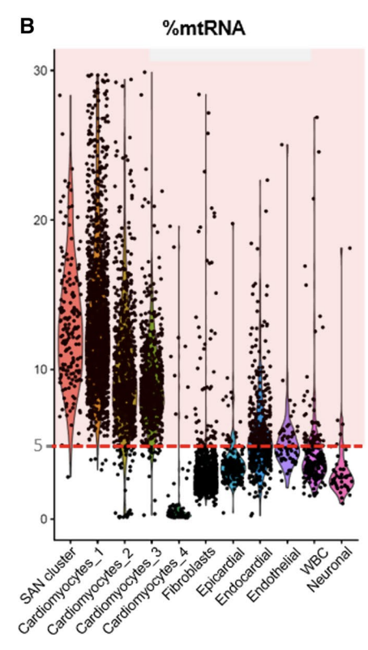
Appropriate quality control filters vary with platform and cell types
Different platforms set different expectations
Example:. Smart-Seq2 often yields more genes detected per cell than 10x Chromium.
Different cell types set different expectations
Immune cells normally have fewer genes detected per cell than non-immune cells
Malignant cells normally have more genes detected per cell than non-malignant cells
Cardiac cells normally have higher percent of mito genes per cells then other cells
Source:

Slide 12
Tips
It may be necessary to revisit quality control decisions multiple times when analyzing data. Often it is beneficial to start with permissive QC thresholds and investigate the effects of these thresholds before going back to perform more stringent QC.
If the distribution of QC covariates differ between samples, QC thresholds should be determined separately for each sample to account for sample quality differences.
Always visualize QC metrics per cluster in order to flag any biases in QC filters that have been applied.
Luecken, M. D., & Theis, F. J. (2019). Current best practices in single‐cell RNA‐seq analysis: a tutorial.

Slide 13
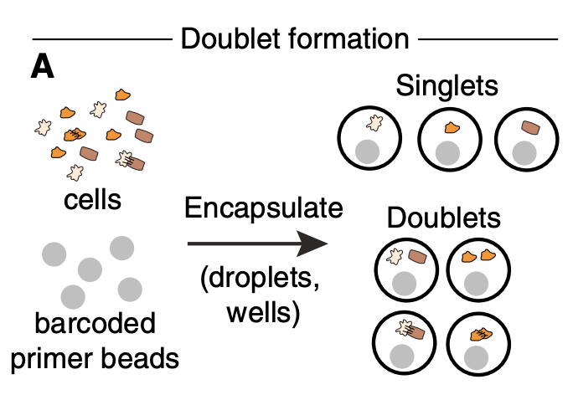
Identifying Doublets in Single-Cell RNA-Seq Data
Doublets = two or more cells captured together
Doublets will contain gene counts from the two combined cells.
Some doublets will be filtered by the basic QC steps since doublets will have a high number of genes and number of UMIs
Wollock et al., Cell Syst., 2019
Notes:
These added ambient counts can distort downstream analysis such as marker gene identification or other differential expression tests especially whenlevels vary between samples.

Slide 14
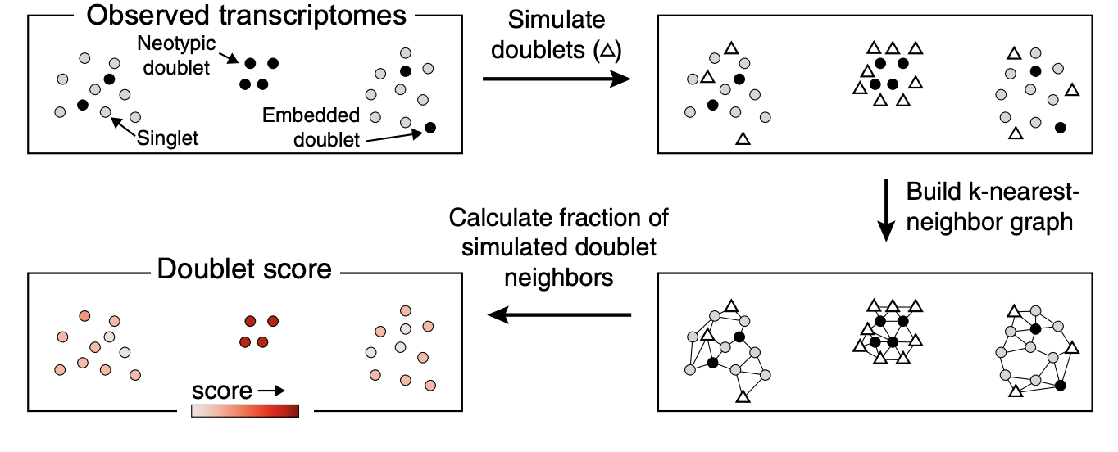
Identifying Doublets in Single-Cell RNA-Seq Data
A simple heuristic to check for doublet clusters is to see if they express gene markers of two or more disparate celltypes.
Advanced methods such as Scrublet and DoubletFinder use simulations to determine doublet scores.
Wollock et al., Cell Syst., 2019
Notes:
These added ambient counts can distort downstream analysis such as marker gene identification or other differential expression tests especially whenlevels vary between samples.

Slide 15
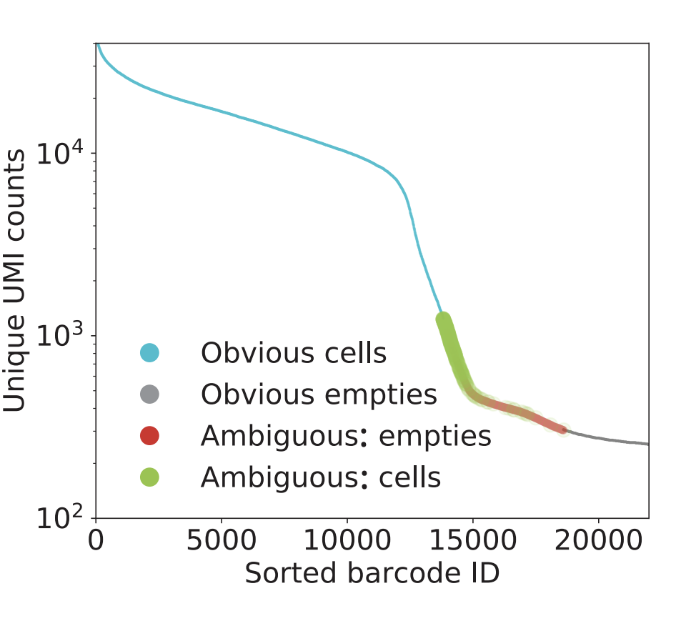
Detecting empty drops and correcting for ambient RNA
Ambient gene expression refers to counts that do not originate from a barcoded cell, but from other lysed cells whose mRNA contaminated the cell suspension prior to library construction.
It is possible to correct for these effects in droplet-based scRNA-seq datasets due to the large numbers of empty droplets, which can be used to model ambient RNA expression profiles.
Notes:
These added ambient counts can distort downstream analysis such as marker gene identification or other differential expression tests especially whenlevels vary between samples.

Slide 16
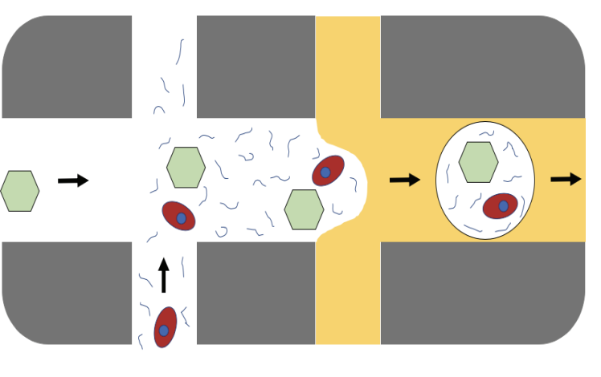
Detecting empty drops and correcting for ambient RNA
Ambient gene expression refers to counts that do not originate from a barcoded cell, but from other lysed cells whose mRNA contaminated the cell suspension prior to library construction.
Sequencing errors in barcodes and Barcode swapping also contribute to ‘ambient’ RNA counts.
The presence of background RNA can lead to systematic biases and batch effects in various downstream analyses such as differential expression and marker gene discovery.
Notes:
These added ambient counts can distort downstream analysis such as marker gene identification or other differential expression tests especially whenlevels vary between samples.

Slide 17
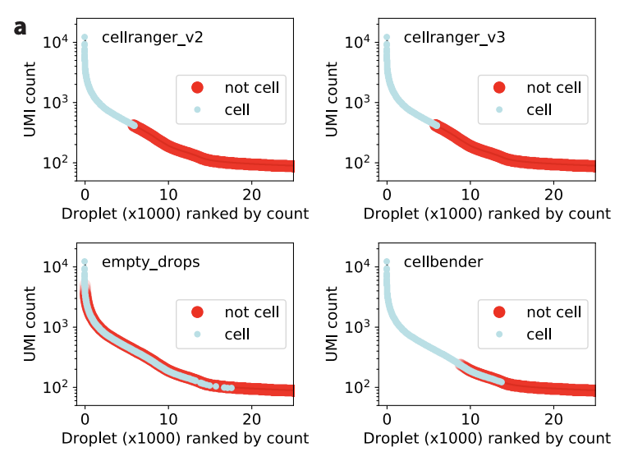
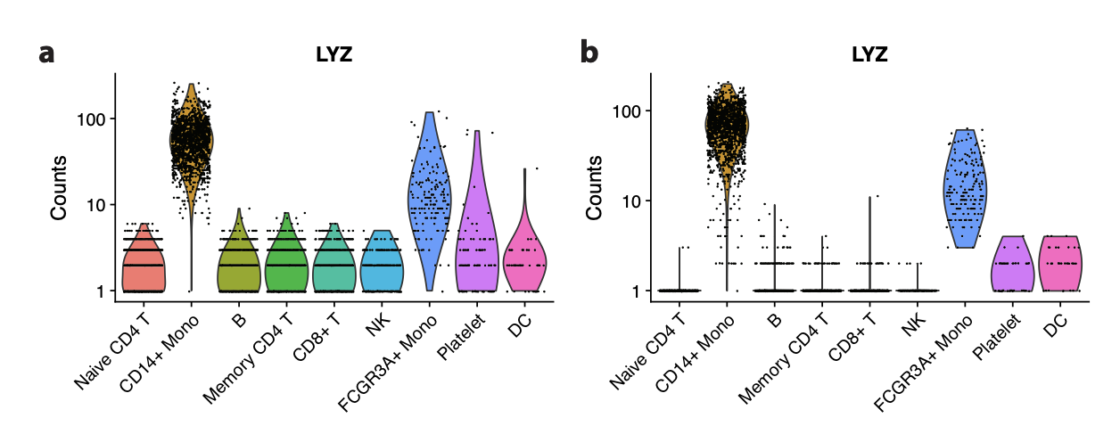
CellBender: Tool to detect empty drops and correct ambient RNA
CellBender removes ambient background and barcode swapping via deep learning
successfully learns and subtracts background noise and artifactual counts from non-empty droplets and leads to significantly increased amplitude and specificity of differential gene expression
Fleming et al. bioRxiv (2019)

Slide 18
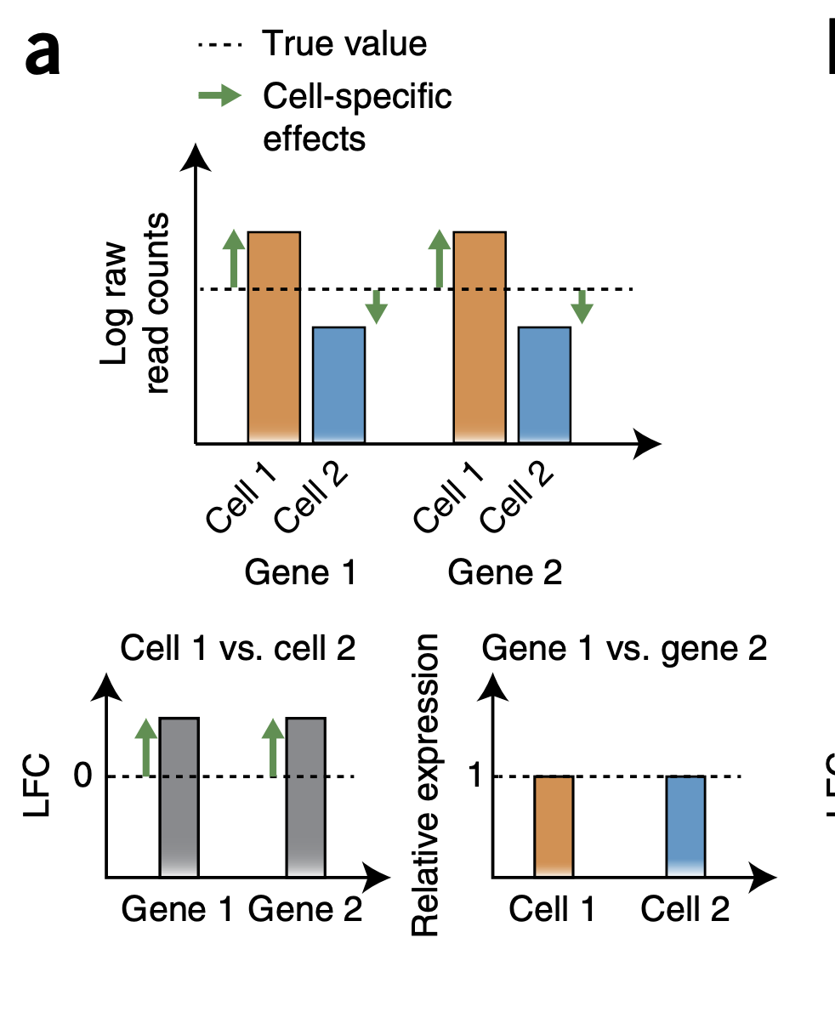
Normalization of gene expression data
Normalization is the process of adjusting raw data to account for unwanted factors that prevent direct comparison of expression measures.
The goal of normalization is for differences in normalized read counts to represent differences in true expression.
In practice, single cell RNA-Seq normalization involves two steps:
Scaling
Transformation
Notes:
Count depths for identical cells can differ due to the variability inherent in the sequencing steps.
When gene expression is compared between cells based on count data, any difference may have arisen solely due to sampling effects.

Slide 19
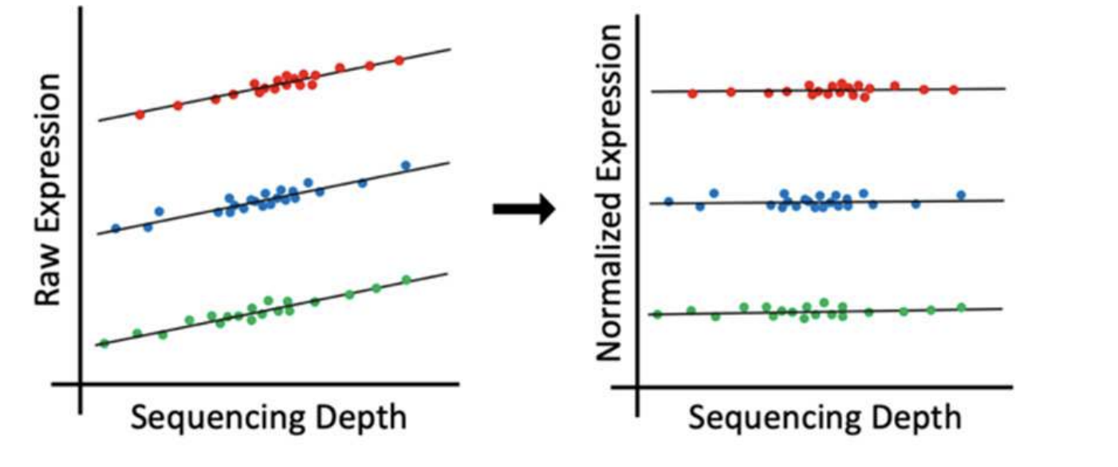
Why normalize gene expression within a cell?
1. Many technical factors such as sequencing depth can introduce bias into the raw read counts obfuscating true signal.
sequencing depth = total number of molecules sequenced
When one cell has a higher sequencing depth than another, even non-differentially expressed genes will tend to have higher read counts in that cell
Notes:
Count depths for identical cells can differ due to the variability inherent in the sequencing steps.
When gene expression is compared between cells based on count data, any difference may have arisen solely due to sampling effects.

Slide 20
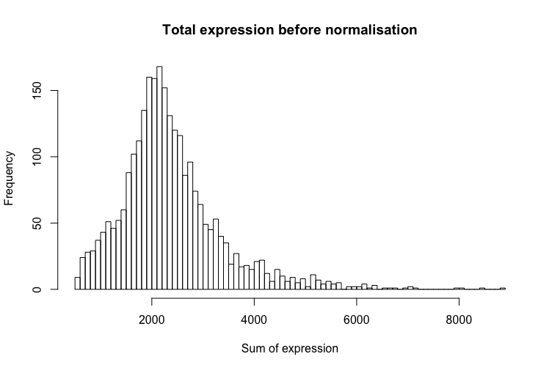
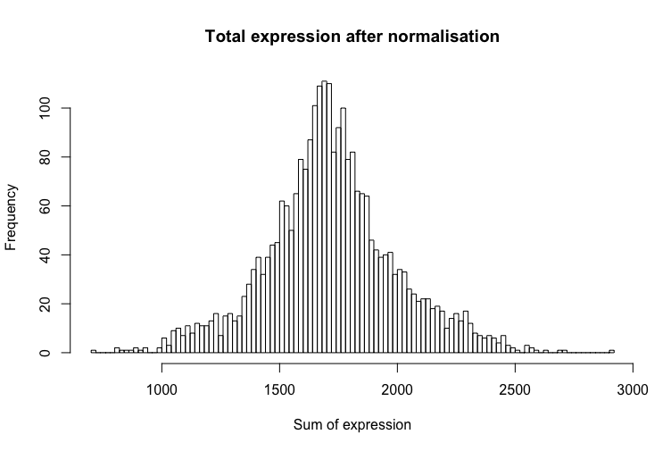
Why normalize gene expression within a cell?
2. There are typically extreme values in distribution of gene expression
Normalization, especially the transformation step, reduces the skew-ness of the data to approximate the assumption of many downstream analysis tools that the data are normally distributed.
Notes:
Count depths for identical cells can differ due to the variability inherent in the sequencing steps.
When gene expression is compared between cells based on count data, any difference may have arisen solely due to sampling effects.

Slide 21
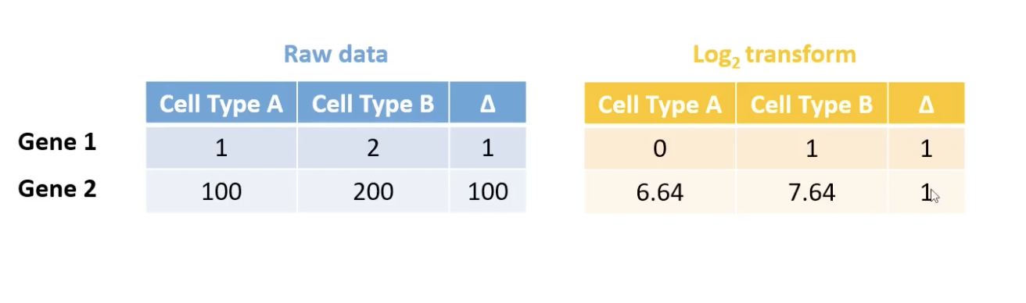
Why normalize gene expression within a cell?
2. There are typically extreme values in distribution of gene expression
Normalization, especially the transformation step, reduces the skew-ness of the data to approximate the assumption of many downstream analysis tools that the data are normally distributed.
Also prevents downstream analysis from being completely dominated by differences among the most highly expressed genes. Log transformation for instance
Notes:
Count depths for identical cells can differ due to the variability inherent in the sequencing steps.
When gene expression is compared between cells based on count data, any difference may have arisen solely due to sampling effects.

Slide 22
Normalization of gene expression data
The most commonly used normalization protocol is count depth scaling, also referred to as “counts per million” or CPM normalization.
To perform CPM:
Gene expression measurements for each cell are normalized by the total gene expression or median gene expression
Gene expression values then scaled to sum to 10,000 (typically),
Finally, these values are log-transformed: log(CPM+1).

Slide 23
Is standard normalization appropriate?
Normalization methods perform poorly when their assumptions are violated
Current approaches to normalization and transformation artificially distort differences between zero and nonzero counts.
Advanced methods like SCTransform can address some of the limitations “Normalization and variance stabilization of single-cell RNA-seq data using regularized negative binomial regression.” Hafemeister et al. Genome Biology (2019)

Slide 24
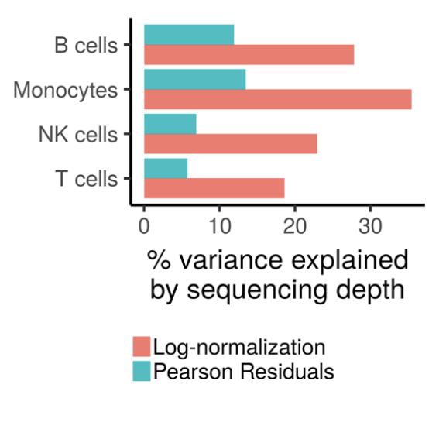
SCTransform: Pearson residual normalization
N

